Slide 1
From Ball Lightning to curing cancer. John J. Lowke CSIRO Manufacturing, Sydney NSW, Australia

Slide 2
Ball Lightning

Slide 3
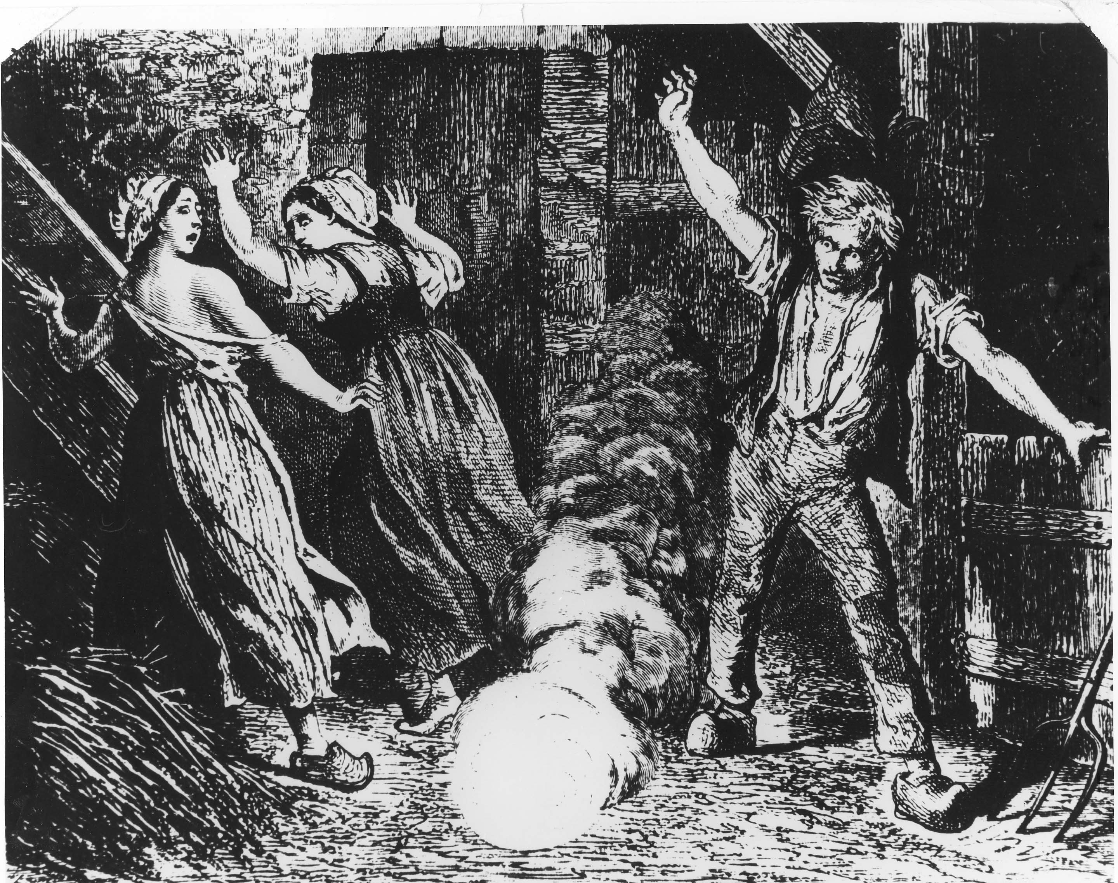

Slide 4
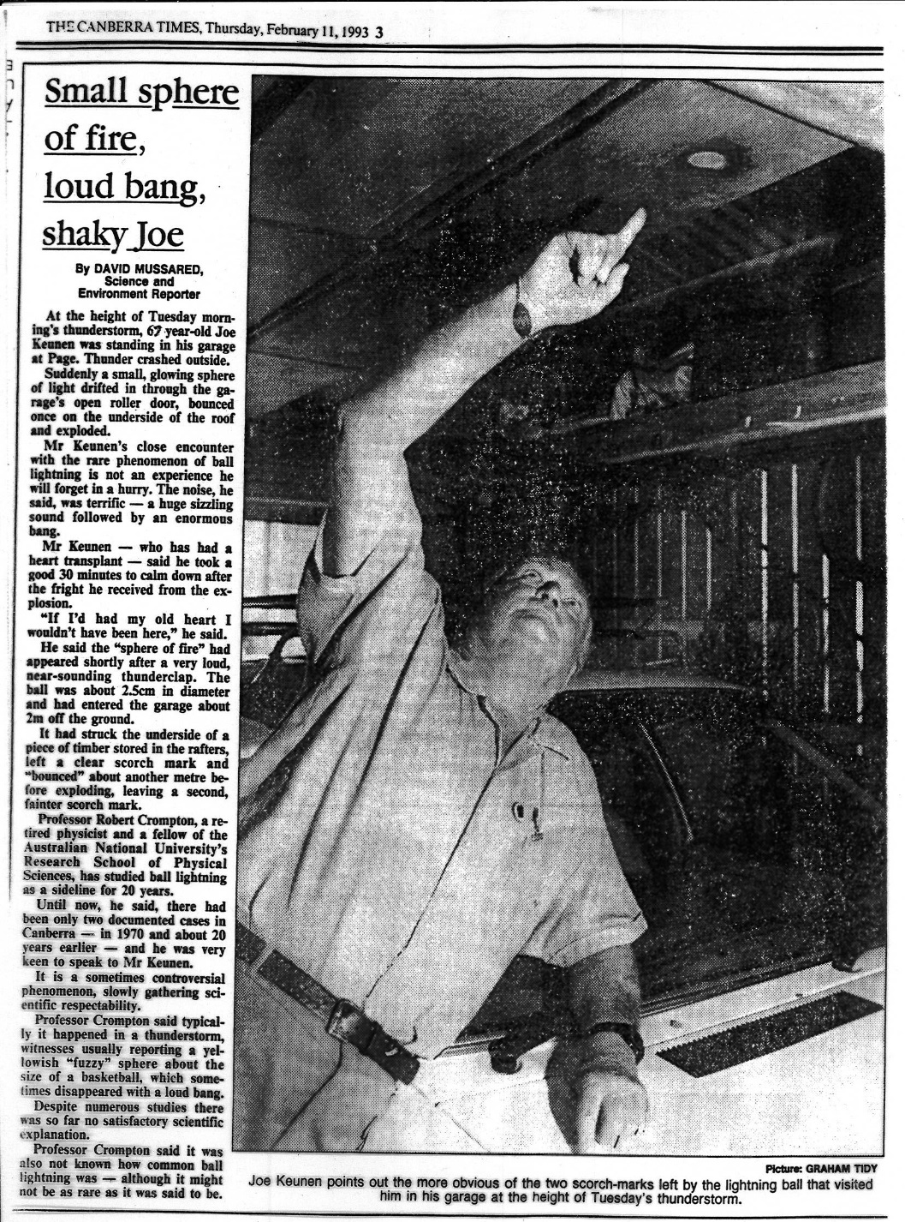
Ball Lightning Observation
Joe Keunan
Canberra, Australia, 1993.

Slide 5
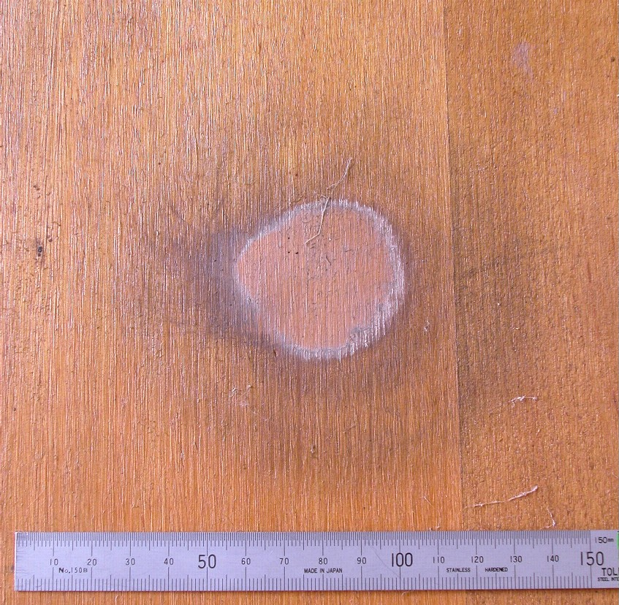
Bounces
First Bounce
Second Impact

Slide 6
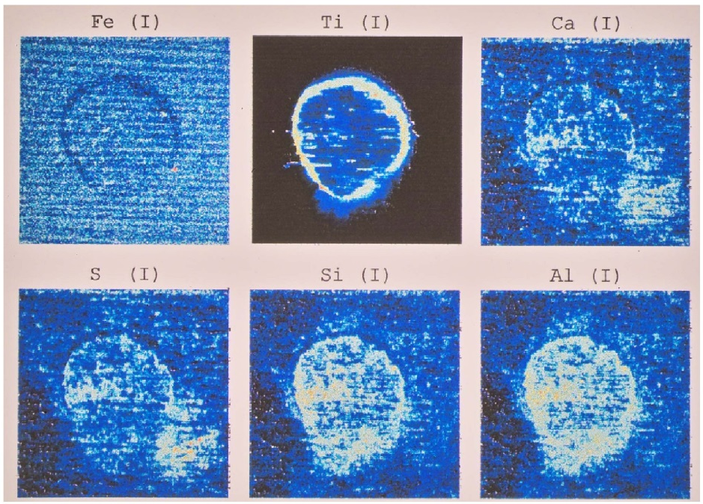
X-Ray Fluorescence Analysis
by Milutin Stoilovic, Forensic Services, Australian Federal Police
Fe Ti Ca
S Si Al

Slide 7
Properties of Ball Lightning
About the size of a large orange.
Lasts about 10 seconds.
Occurs outside, but also inside of houses and aeroplanes.
Sometimes appears from closed glass windows – leaving no trace.
Brightness of a 100W incandescent light bulb.
Some extinguish with a loud bang.
About one person in 100 have seen it once in their lifetime,
usually during a thunderstorm.

Slide 8
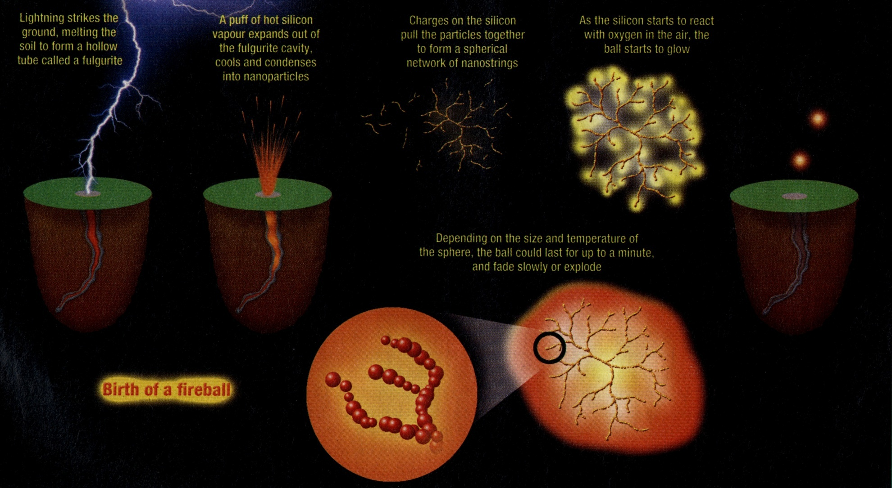
Burning Silicon Fluff – Abrahamson & Dinniss SiO₂ + C → CO₂ + Si; Si + O₂ → SiO₂

Slide 9
Metastable oxygen molecules detach Electrons from Negative Ions
Metastable formation e + O₂ → O₂* + e
O₂* is the a¹Δ_{g} state of oxygen
Negative Ion formation e + O₂ → O₂⁻
Detachment of Negative Ions O₂⁻ + O₂* → 2O₂ + e

Slide 10
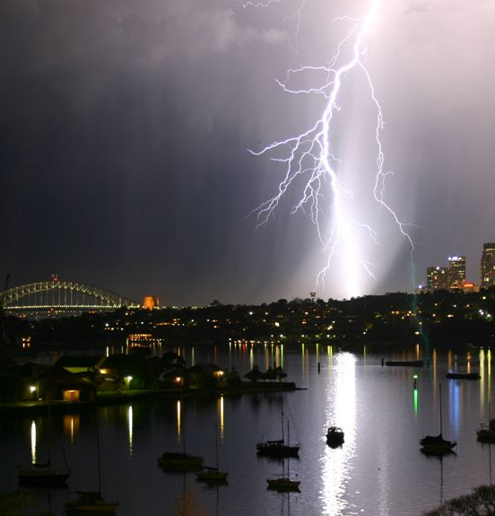
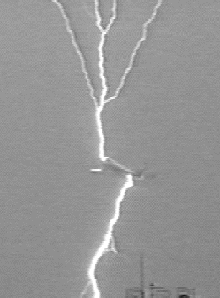
Ions in the sky

Slide 11
Ball Lightning through windows
Glass
-
-
-
-
-
-
-
+
+
+
+
+
+
+
Ball
Lightning
Net Negative Charge
- - -
- - -
- - -
Positive Ion stream
Background E field
Background E field doubled!
Lowke et al J. Geophys. Res. 117, D19107, 2012

Slide 12
Ionization and Attachment Coefficients in Air at 1 bar.

Slide 13
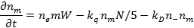
Equations
Electrons
Positive Ions
Negative Ions
Metastables
Space Charge
+
+
∇ ⋅ E =

Slide 14
Calculated Particle Densities

Slide 15
Calculated Volt-Amp Characteristics with oxygen Metastables

Slide 16
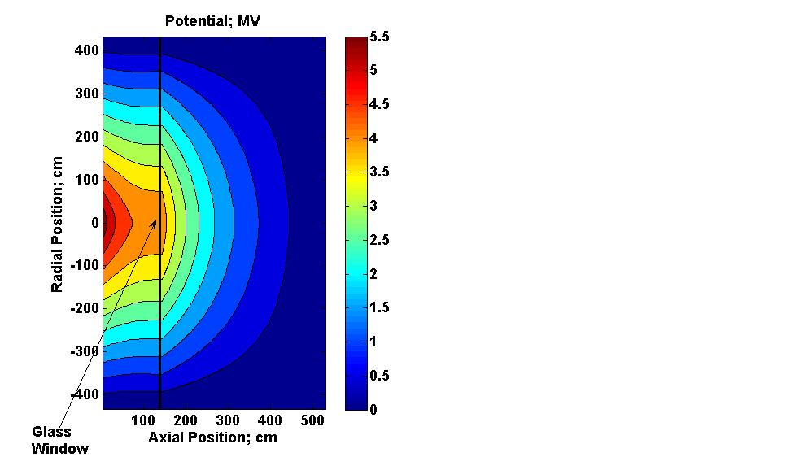
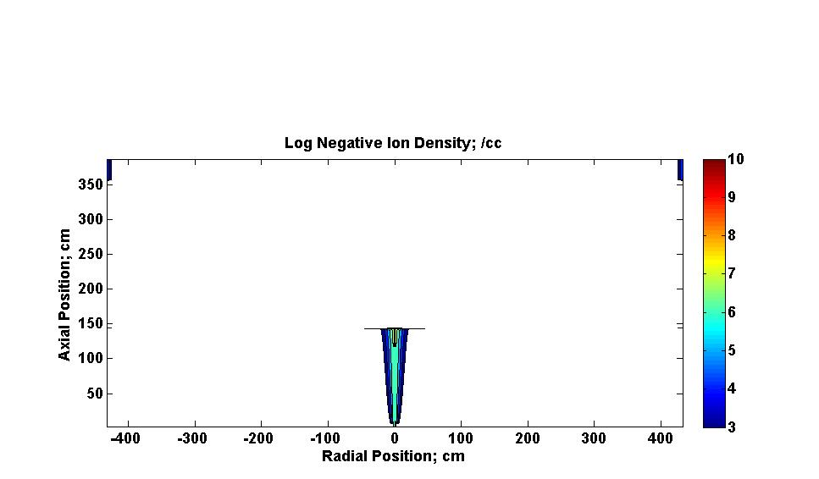
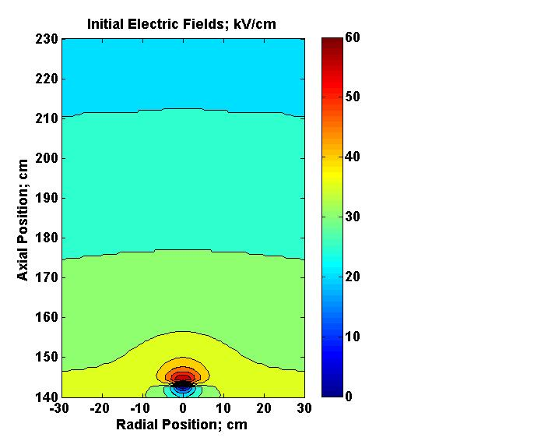
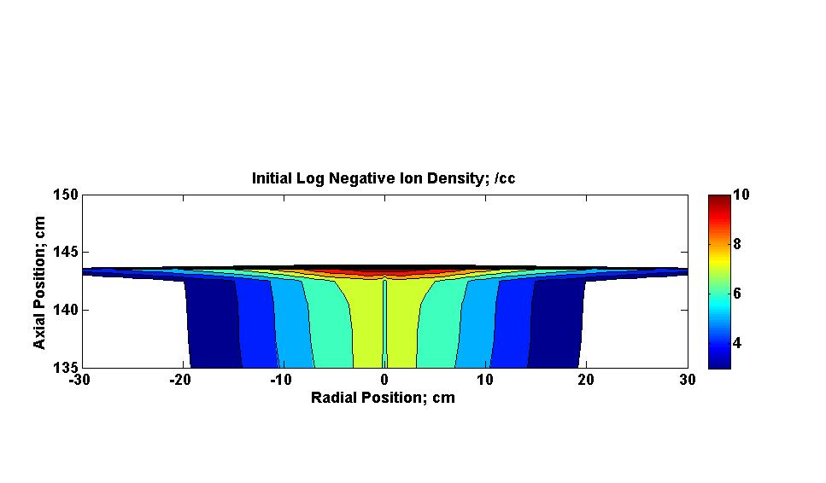
Pulse Calculations at Glass Window; (1) 0 µs; 4 MV
Initial Field
kV/cm
Initial Boundary
Potentials
Log Negative
Ions; /cc
Log Incident
Negative Ions; /cc

Slide 17
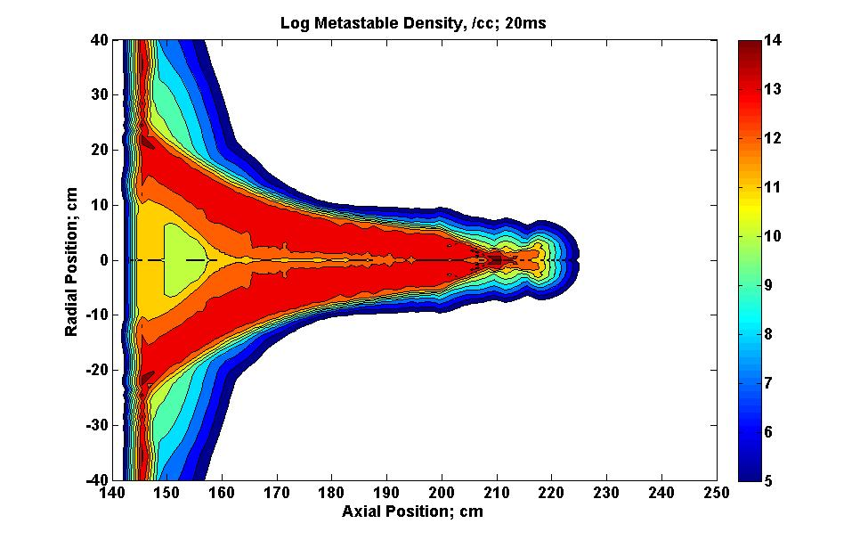
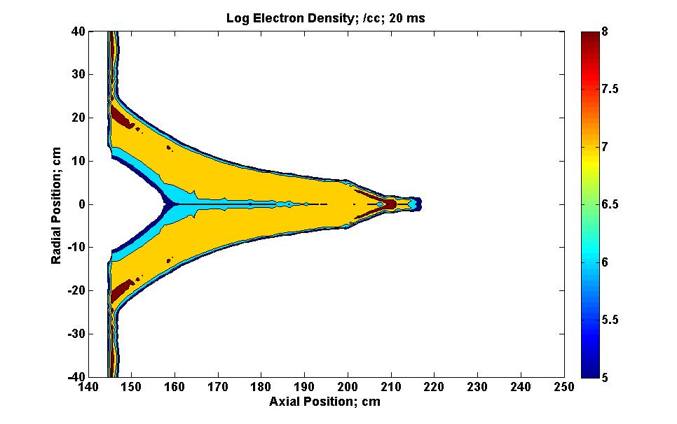
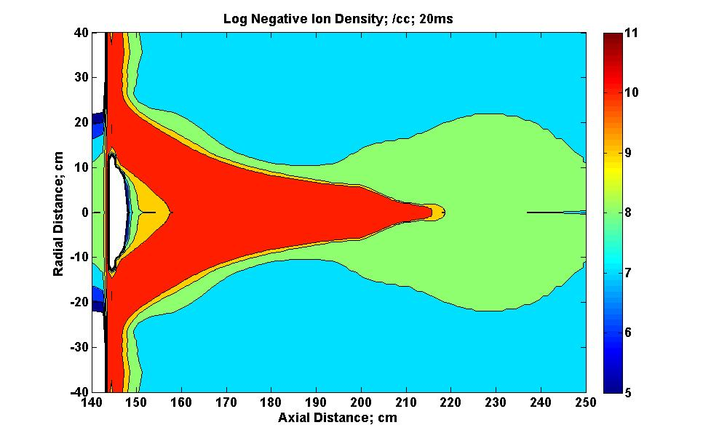
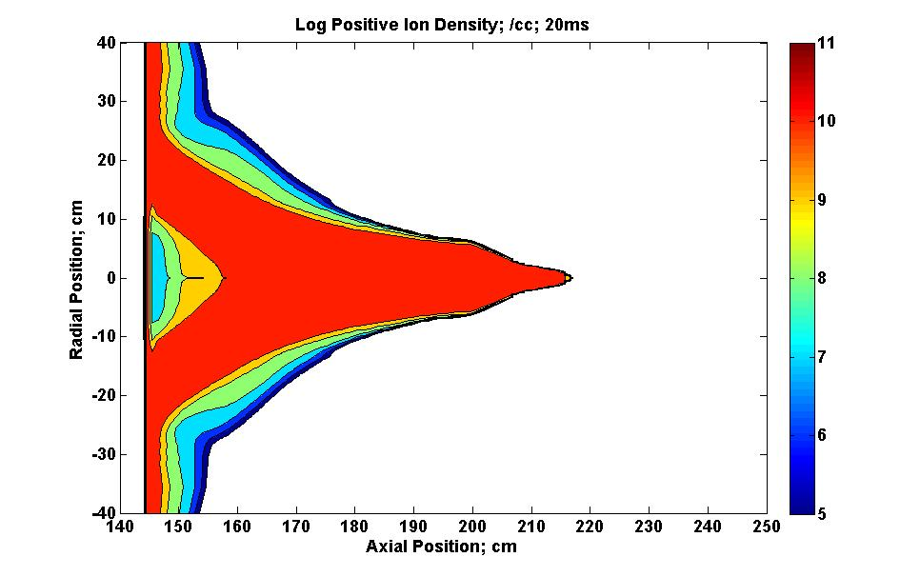
Particle Densities

Slide 18
Ball Lightning through windows
Glass
-
-
-
-
-
-
-
+
+
+
+
+
+
+
Ball
Lightning
Net Negative Charge
- - -
- - -
- - -
Positive Ion stream
Background E field
Background E field doubled!
Lowke et al J. Geophys. Res. 117, D19107, 2012

Slide 19
Discharge is Pulsed!

Slide 20
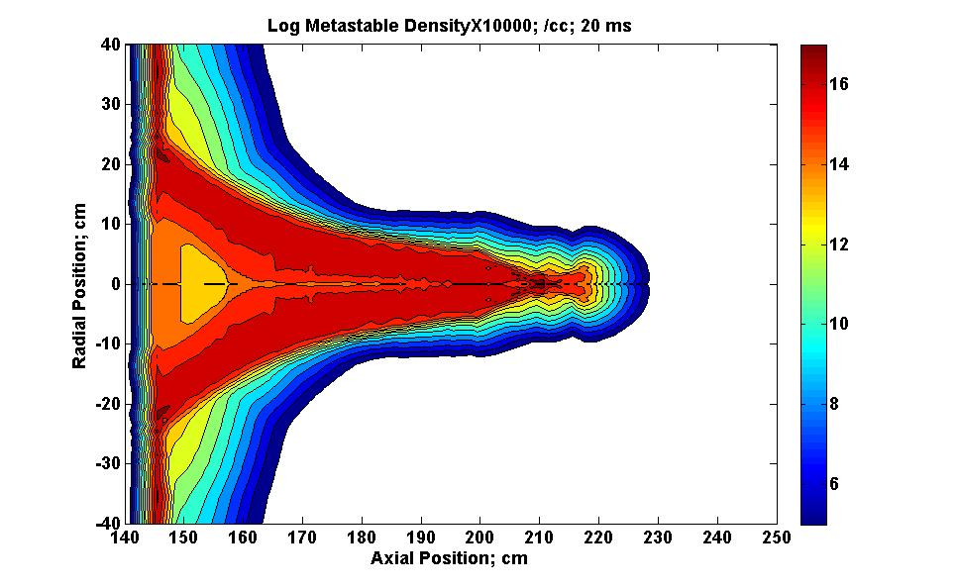
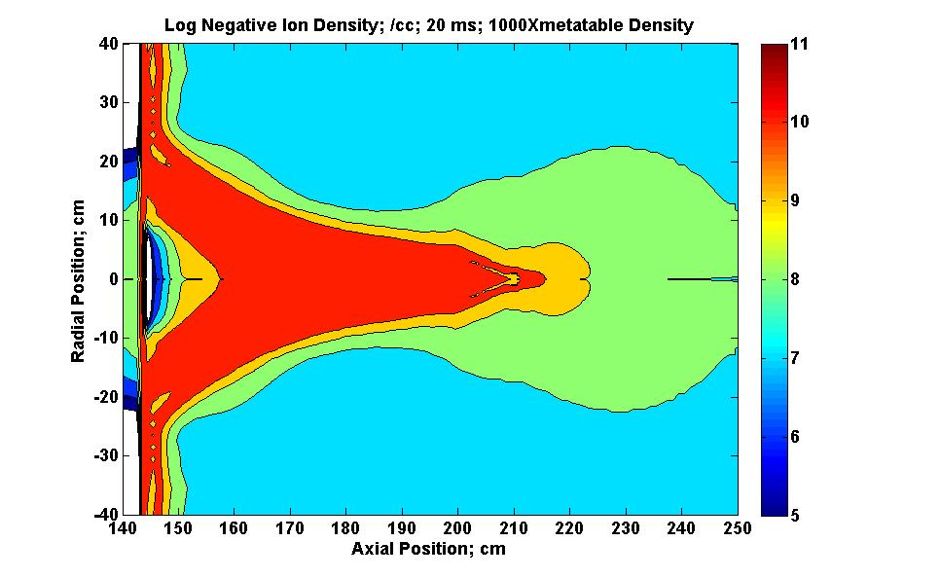

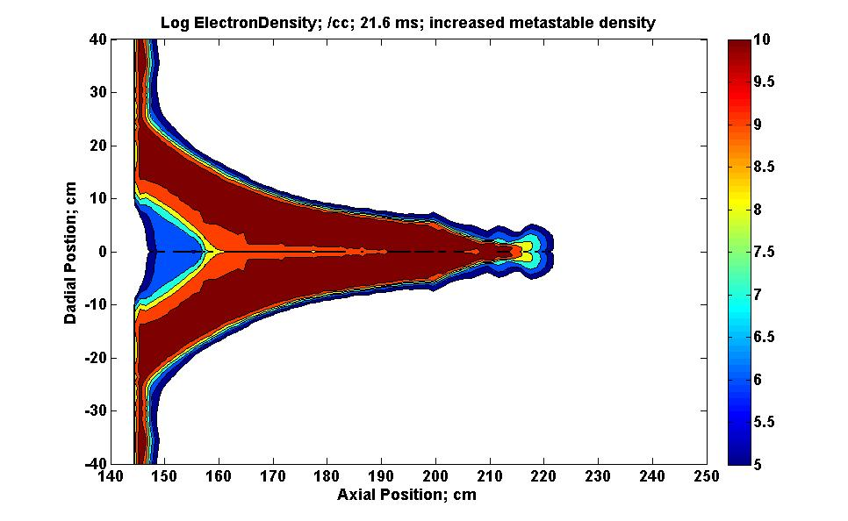
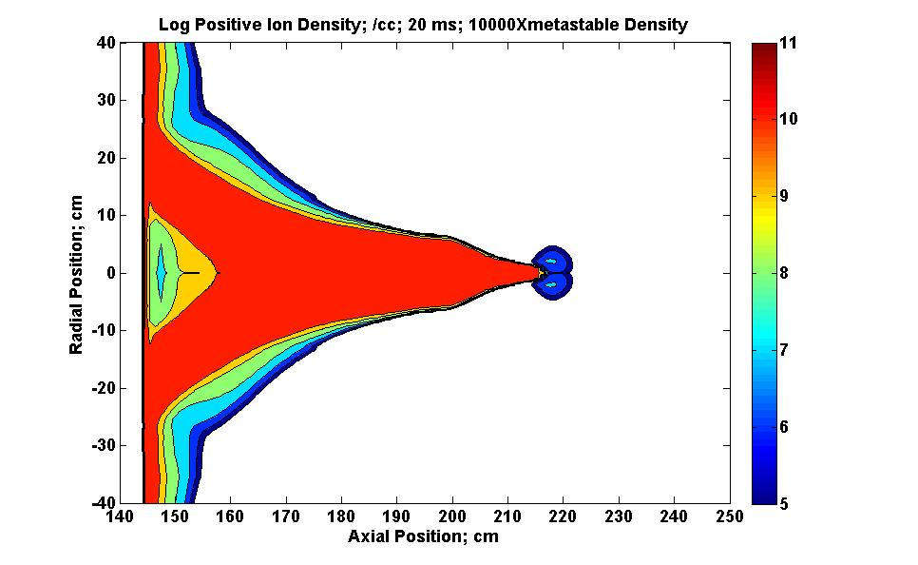

Particle Densities after Metastable Density increased to 10¹⁷ /cc

Slide 21
Thousands of Pulses
Equilibrium of electron attachment to form negative ions and
electron detachment from Negative Ions by metastables.
Negative Ion formation e + O₂ → O₂⁻
Detachment of Negative Ions O₂⁻ + O₂* → 2O₂ + e
∂n_{m}∂t = n_{i} n_{m} k_{D} = n_{e} n_{o} k_{a}
= 1/ n_{i} k_{D} ~ 10 s for n_{i} = 10⁹ /cc
n_{e}/ n_{i} = n_{m} k_{D}/n_{o} k_{a} = 0.001
need n_{m} ~ 10¹⁷/cc

Slide 22
Energy
Ball Lightning 1 % 100 W Incandescent light for 10 s = 10 J
Ball, Radius 10 cm, metastable density 10¹⁷ /cc
Energy = 1V × 10¹⁷ × e (10⁻¹⁹) × 10³ = 10 J

Slide 23
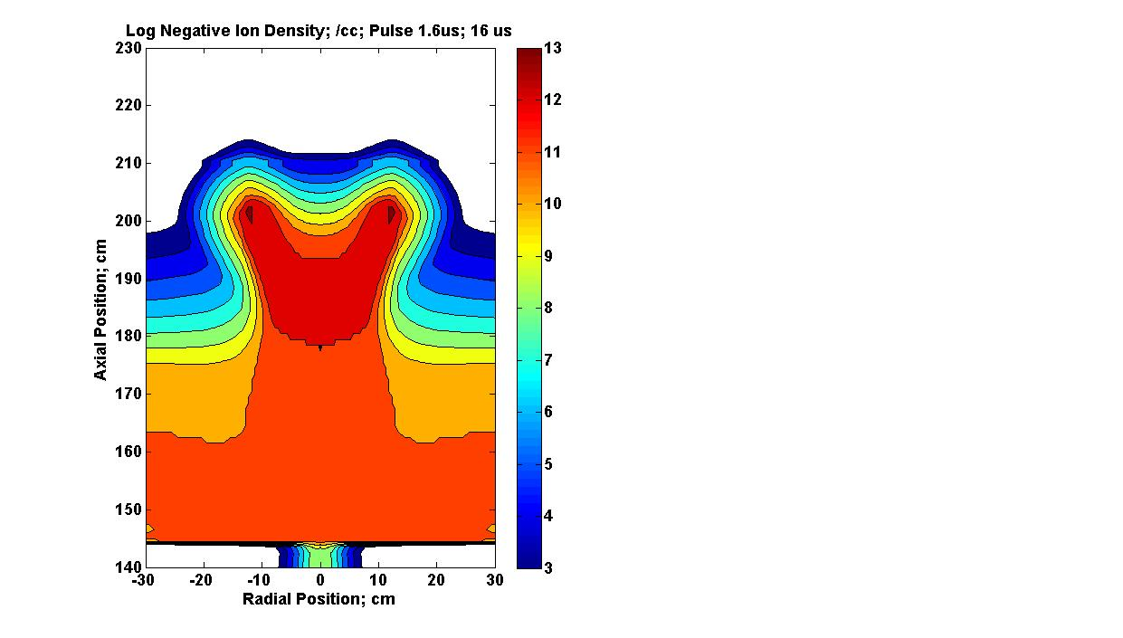
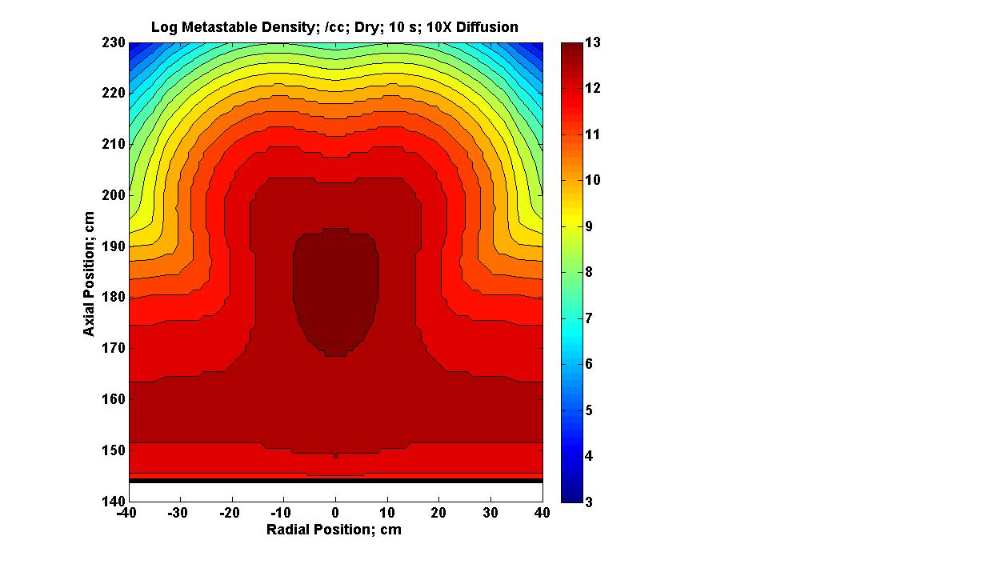
Circular Shape
Effect of Diffusion of metastables
Initial
After Diffusion

Slide 24
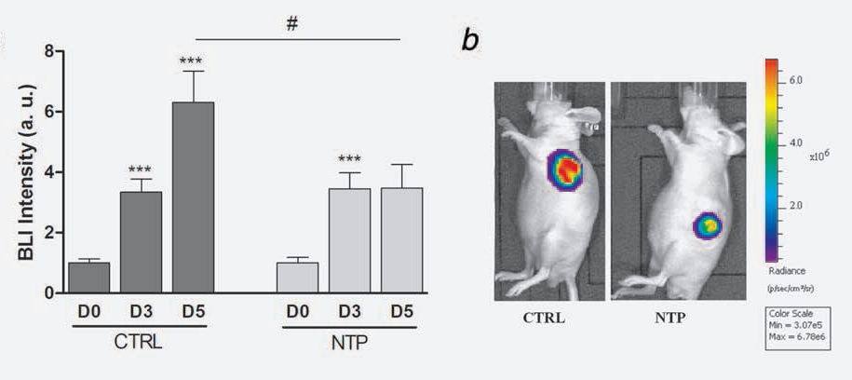
Non-Thermal Plasmas (NTP)
Reduce Cancer Tumors!
M. Vandema et al, Int. J. et Cancer, 130(9), 2185, 2012

Slide 25
Starting “Start-Up” companies
New Idea: useful, marketable, profitable
Laboratory device – to demonstrate function
Commercial device – to be saleable
Capital – maybe millions of dollars
People – patent lawyers, managers, buildings, sales staff;
increase costs by factor of 5

Slide 26
New Plasma Instrument
Ozone
e + O₂ ➔ e + O + O
requires 4.4 eV electron energy
O + O₂ ➔ O₃ ozone
a¹Δ_{g}
e + O₂ ➔ e + O₂ a¹Δ_{g}
requires only 1.0 eV electron energy
Can we design new instrument for reduced ozone?

Slide 27
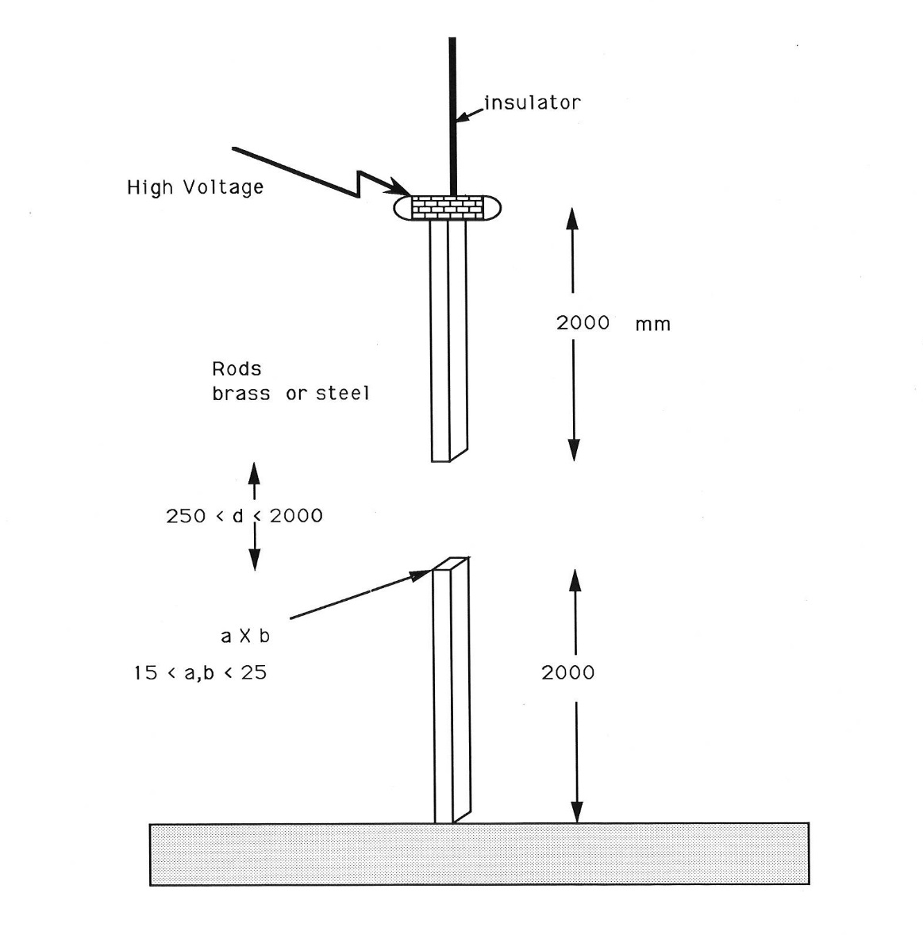
Measurement of Breakdown Voltage. Feser and Hughes; Electra 117, 23, 1988,

Slide 28
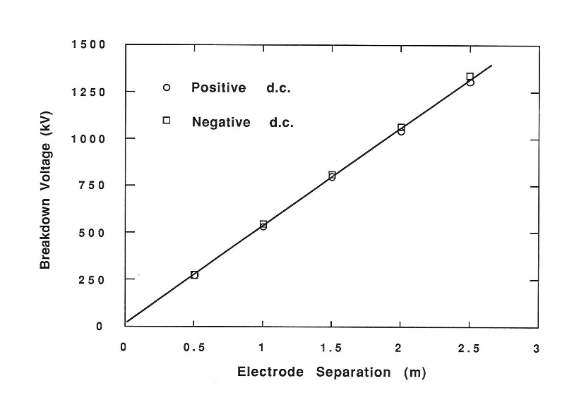
Measured Breakdown Voltage as a function of electrode separation.

Slide 29
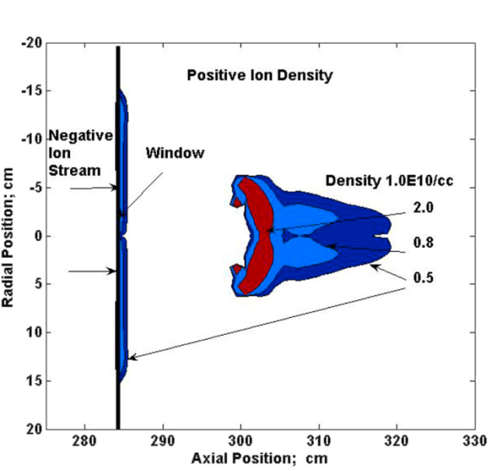
Calculated Discharge on far side of glass
Positive Ion Densities /cc

Slide 30
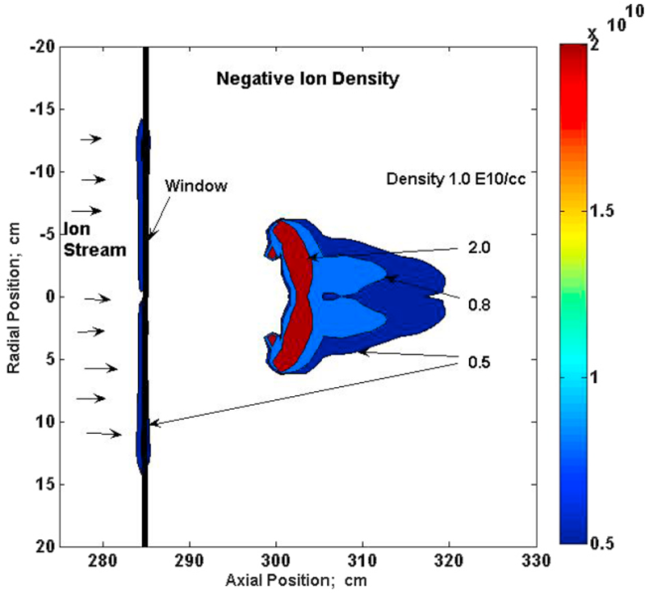
Calculated Discharge on far side of glass
Negative Ion Densities /cc

Slide 31
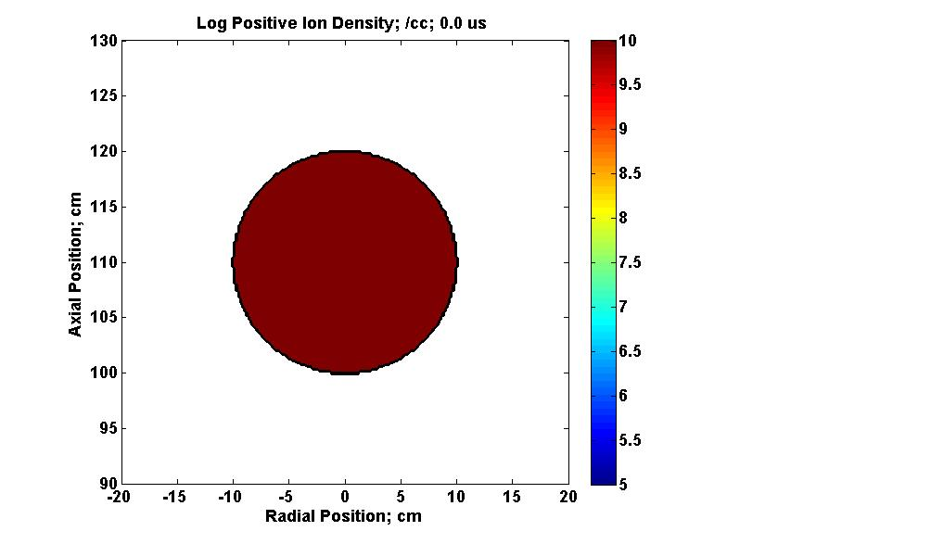
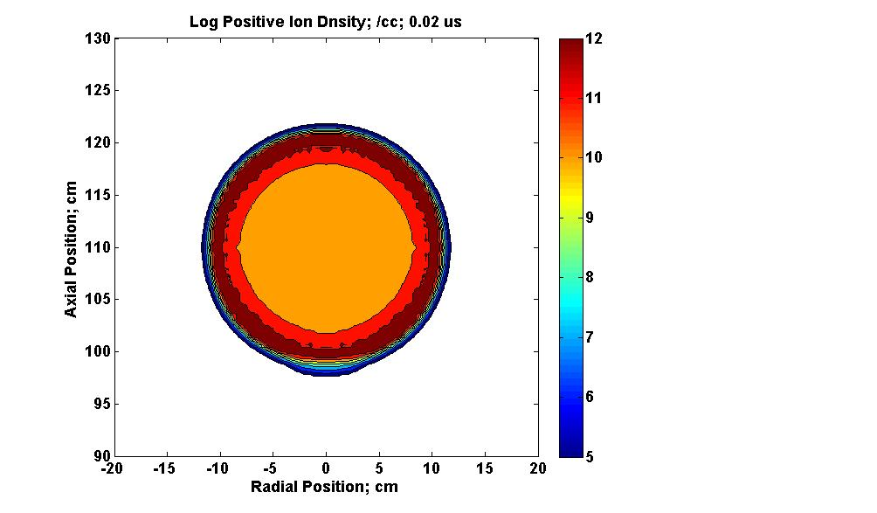
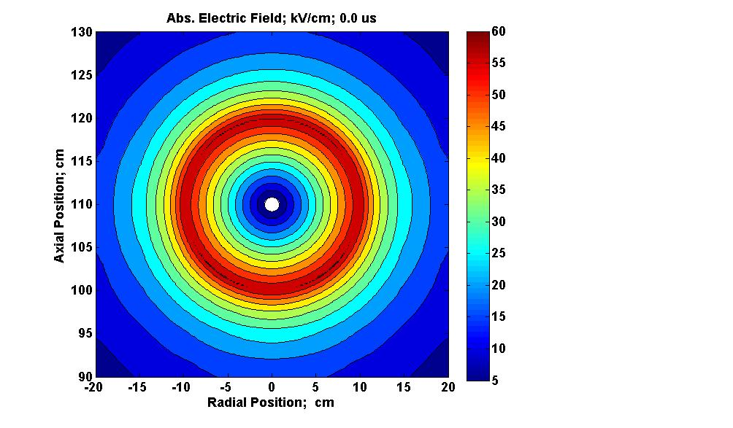
Development of Ball of Positive Ions; density 10¹⁰ /cc
(1) Density Positive Ions 0.02 µs

Slide 32
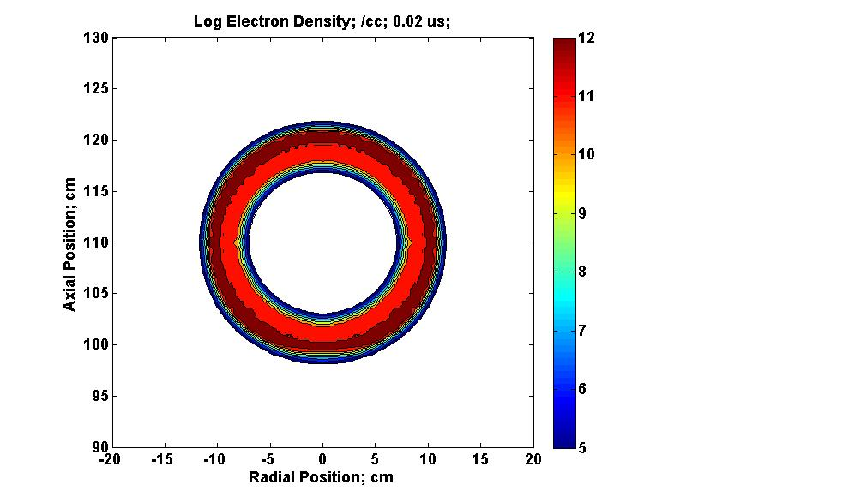
Ball of Positive Ions; density 10¹⁰ /cc
(2) Density Electrons 0.02 µs

Slide 33
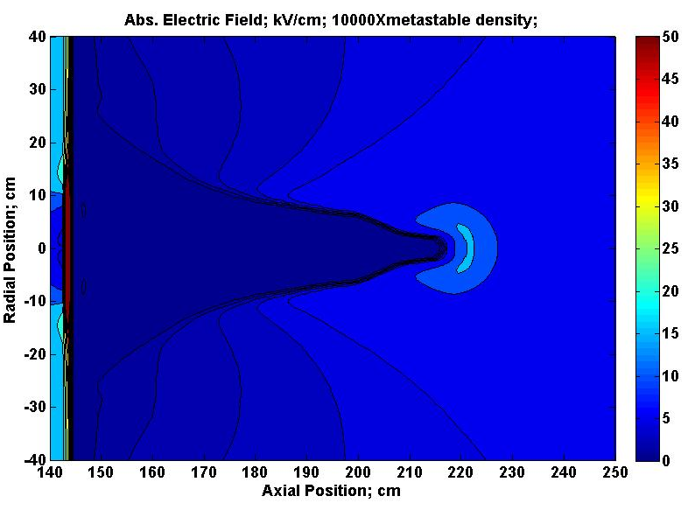
Electric Field

Slide 34
Pulses R Morrow J Phys D 30,3099 1997
Theory
Experiment

